Slide 1
Image Segmentation for Object Detection

Slide 2
Overview
Humans can easily detect and identify objects present in an image as compared to a computer.
However, with the availability of large amount of data, refer GPUs, and better algorithms, we can now easily train computers to detect and classify multiple object within an image with high accuracy.
We explore term such as object detection, localization, loss function for object detection and finally explore an object detection algorithm.

Slide 3
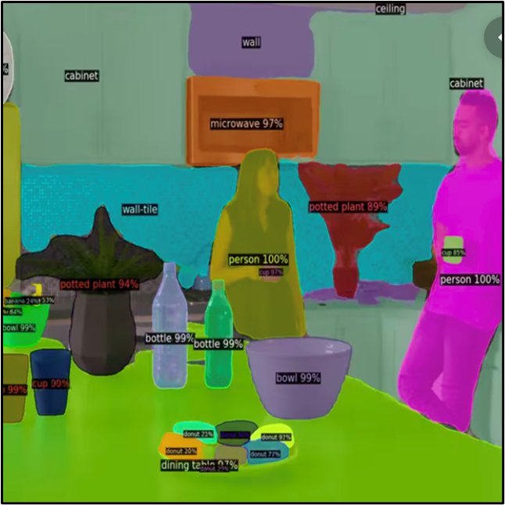
Problem Statement
Conventional object detectors use bounding boxes to label the data while training and output an array of bounding boxes around objects detected in the image. This method of detecting objects is old.
In our project, we will use Detectron2 for image segmentation and object detection.
Detectron2 is Facebook’s recently introduced AI Research's (FAIR) framework.
Includes Mask R-CNN, RetinaNet, Faster R-CNN, RPN, Fast R-CNN, TensorMask, PointRend, DensePose, and more.

Slide 4
Methodology
Procedure to train the model and use it for prediction:
Building custom dataset
Registering the Dataset
Training the model
Saving the model
Making Inference
Each team member has taken up two object classes, extracted the images either from Google or from their home environment, and then created the dataset using LabelMe.

Slide 5
Creating datasets
Using LABELME

Slide 6
GOAL
To create image annotation to supply it to our model for training purposes.
https://viso.ai/computer-vision/image-annotation/

Slide 7
Reason for selecting LabelMe
Labelme is a graphical image annotation tool
It has a simple user interface
It allows us to create and edit polygons around object
Generates corresponding JSON file with all the information about the image

Slide 8
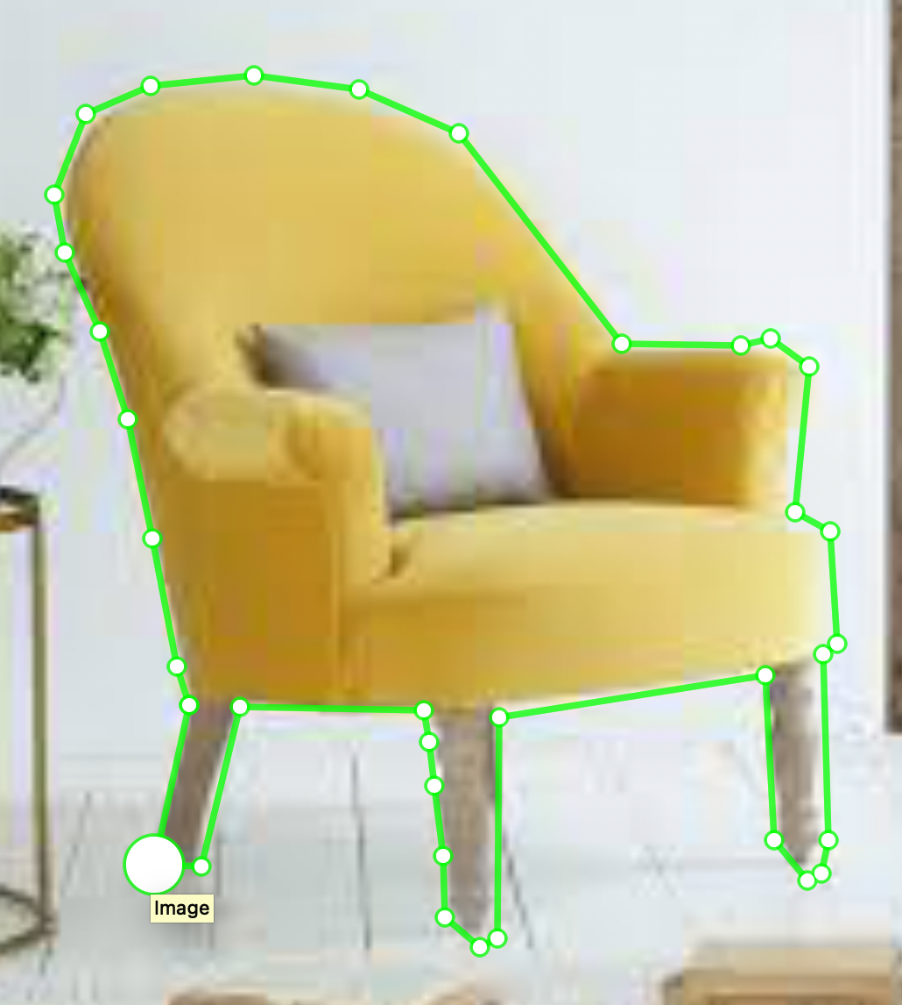
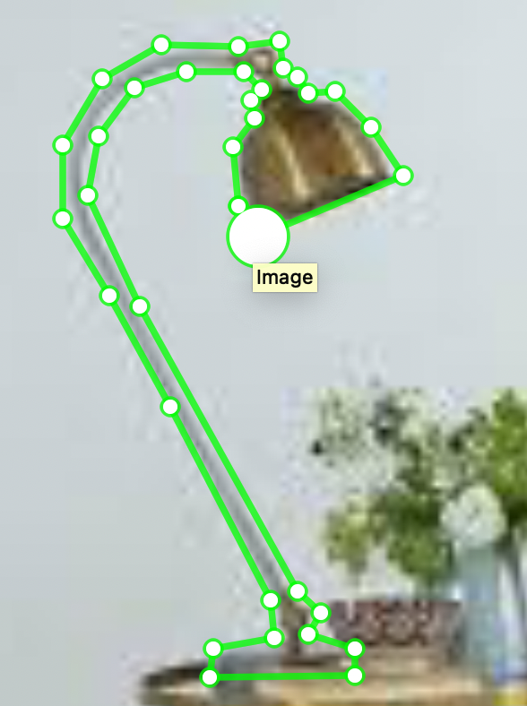
Selecting objects for classes using LABELME
Chair
Lamp

Slide 9
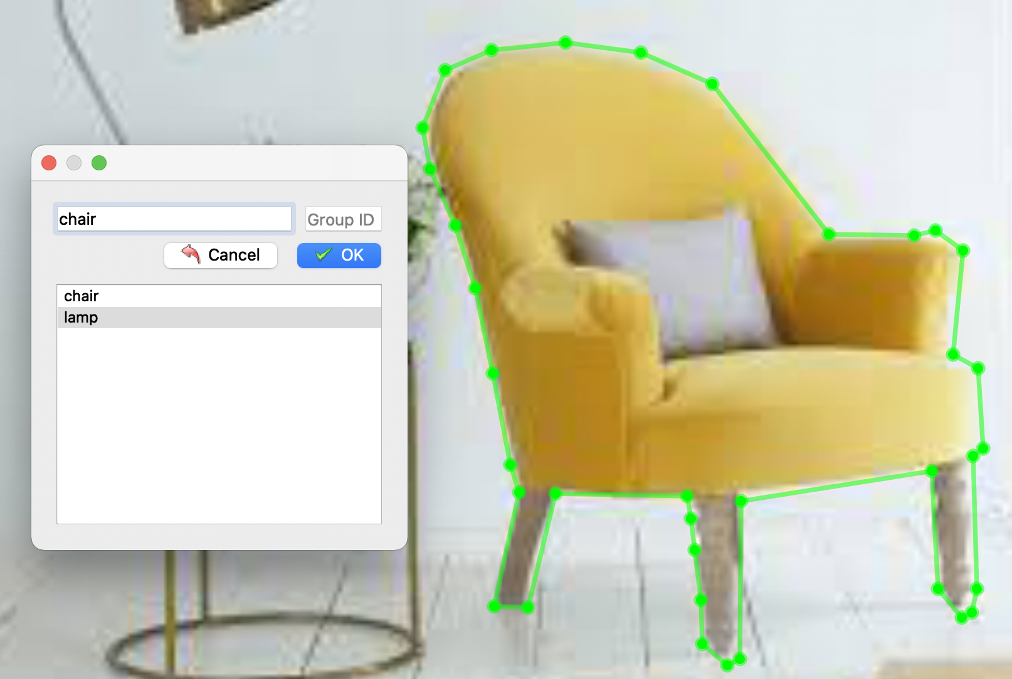
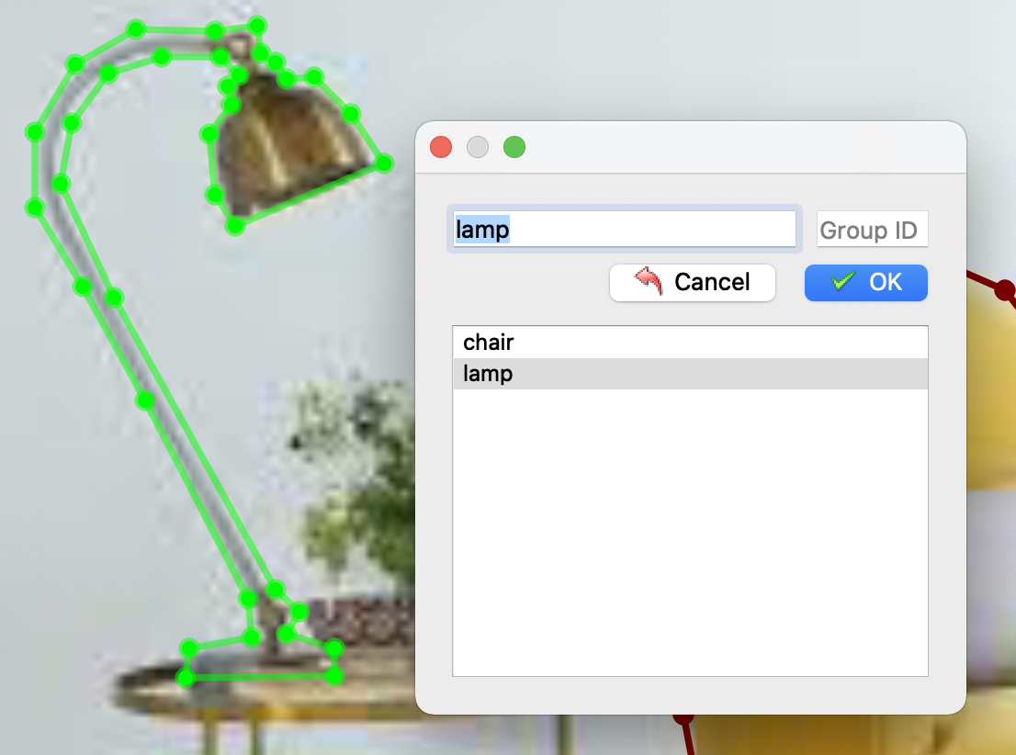
Labelling polygons for classes using LABELME

Slide 10
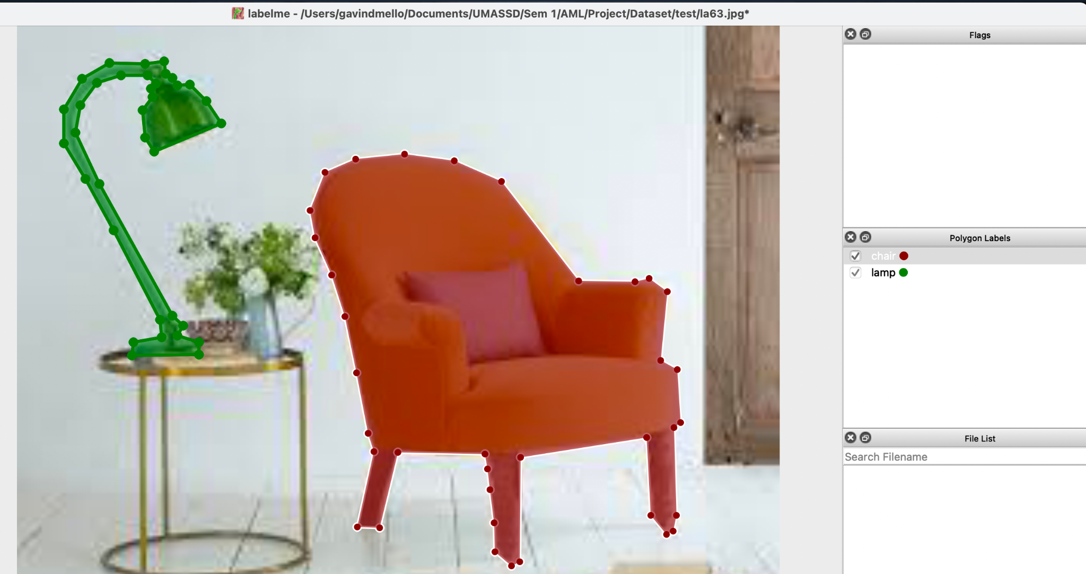
Multiple polygons in one single image

Slide 11
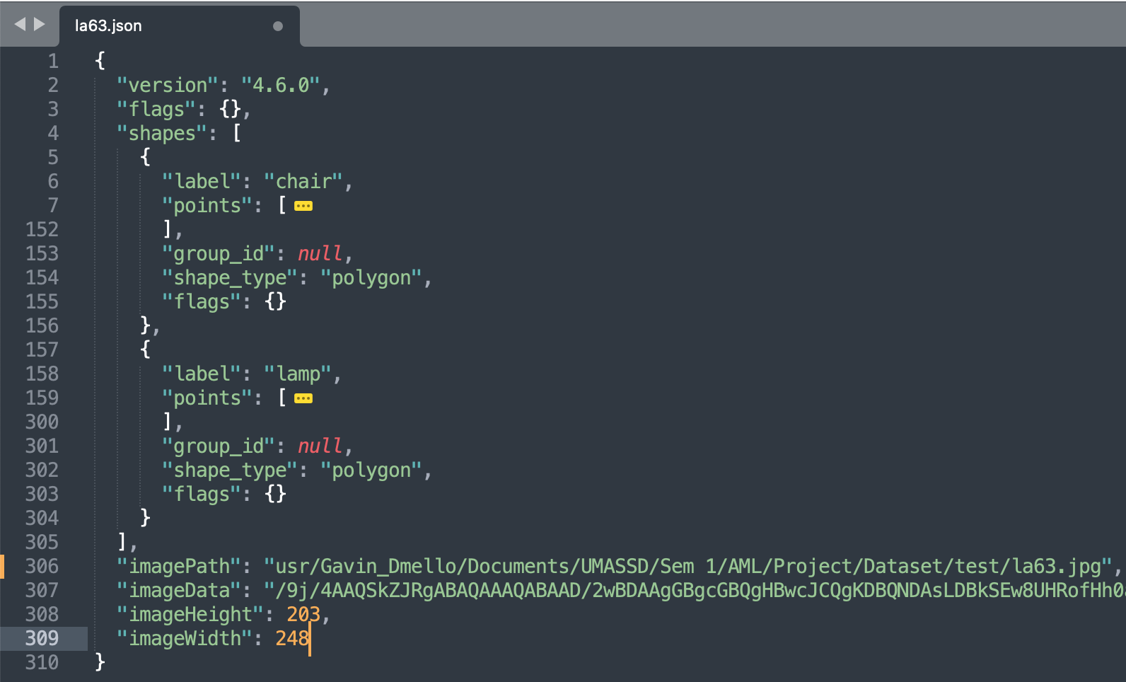
Output JSON File from LABELME for an Image
chair object
Array of co-ordinates for points that represent a chair
lamp object
Array of co-ordinates for points that represent a lamp
Source path of image on local machine
Height of image la63.png
Width of image la63.png

Slide 12
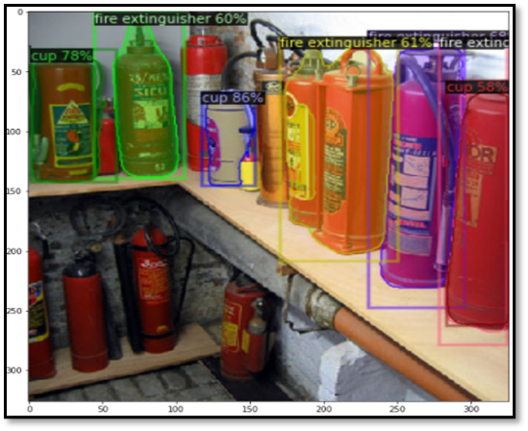
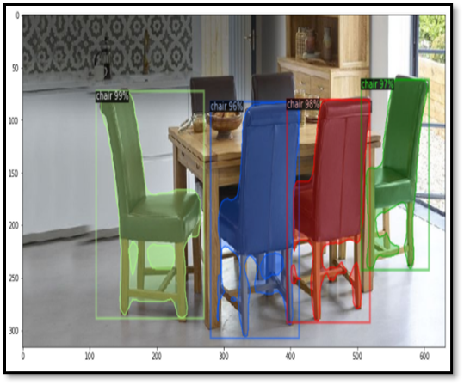
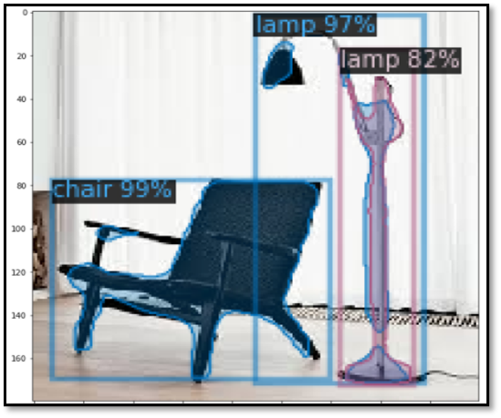
Results

Slide 13
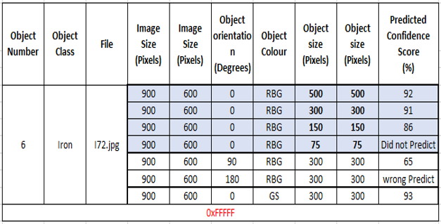
Rigorous Testing
← Keeping the image size, orientation and object colour constant and varying the object size.

Slide 14
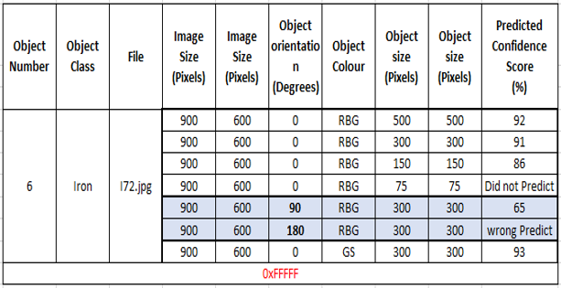
Rigorous Testing
← Keeping the image size, object color and object size constant and varying the Orientation.

Slide 15
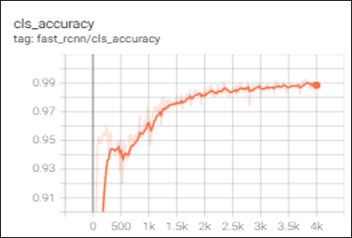
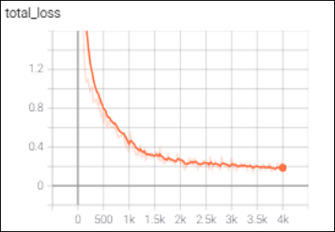
Performance Evaluation
(Training Accuracy)

Slide 16
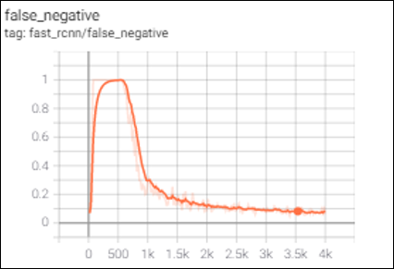
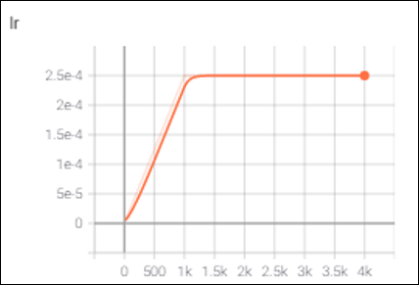
Performance Evaluation
(Training Accuracy)

Slide 17
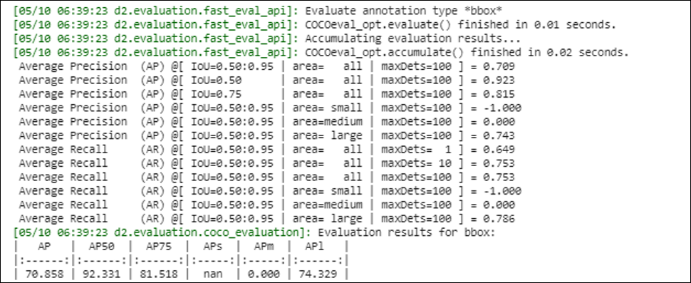
Performance Evaluation
(Testing Accuracy)
Figure displays the Average Precision(AP) and Recall of the trained model

Slide 18
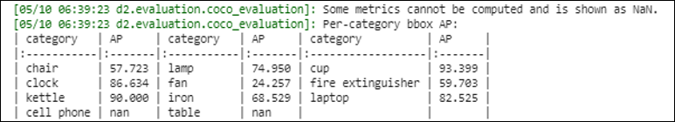
Performance Evaluation
(Testing Accuracy)
Figure displaying the Average Precision(AP) of individual Classes

Slide 19
THANK YOU.

